Slide 1
Netflix Movie Data Analysis
By -: Nitin Sharma

Slide 2
Netflix Movie Data Analysis Project
Netflix is known for its work in data science, AI, and ML, particularly for building strong recommendation models and algorithms that understand customer behavior and patterns. Suppose you are working in a data-driven job role, and you have a dataset of more than 9,000 movies. You need to solve the following questions to help the company make informed business decisions accordingly.
What is the most frequent genre of movies released on Netflix?
Which has highest votes in vote avg column?
What movie got the highest popularity? what's its genre?
What movie got the lowest popularity? what's its genre?
Which year has the most filmmed movies?

Slide 3
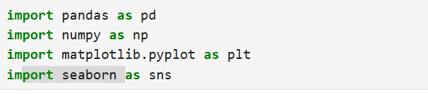
Importing different modules in the jupyter notebook

Slide 4

Importing Data from a csv file.
Here-:
Df = Name of the variable of we can say data frame in which the data is stored.
Pd.read_csv = this is the function of pandas for reading csv files
Lineterminator = this is used when our data is not formatted correctly so we can use next line (\n) as line terminator

Slide 5
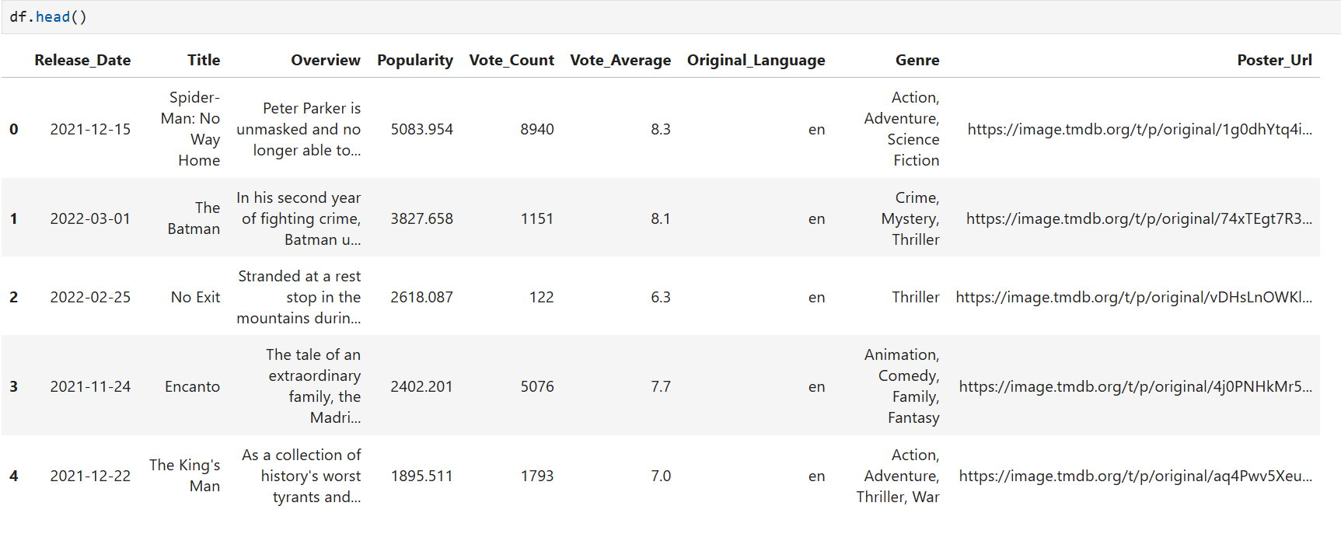
Basic picture of our data-:

Slide 6
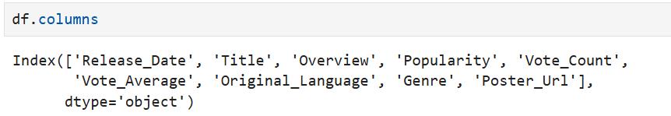
List of all the columns of the data

Slide 7
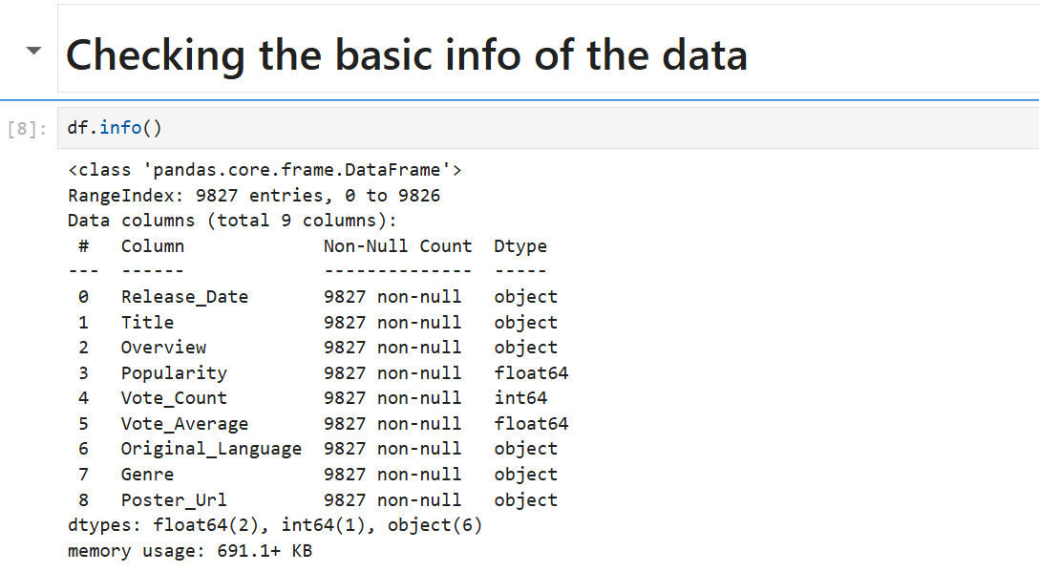
Now we will see the basic information about the data-:
Conclusions from the info of data-:
Total number of rows or we can say no of entries = 9827.
There is no null entries in the data.
There are three data type in the data-: object, int, float

Slide 8
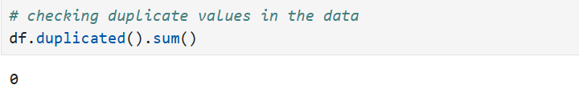
Data Cleaning Processes-:
Duplicate values checking-: df.duplicated() – this will give bollean expressions for every row.
Df.duplicated().sum() – this will give the sum of duplicate values from all rows like there are ____ toatal duplicate rows for example avengers endgame movie is there in the data for 6 times..

Slide 9
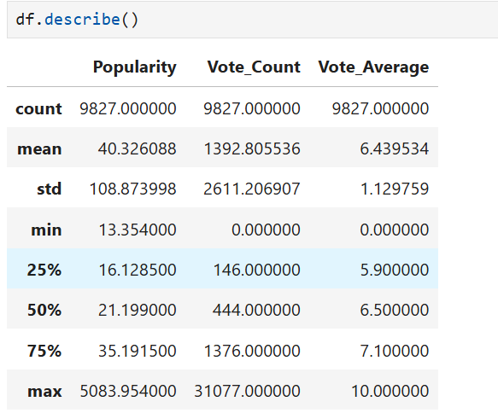
Basic statistics on columns containing numerical values-:
Describe function tells us the basic statistics like mean, median maximum from the complete column
For example-: it tells us that the mean of popularity of movies is 40.323088.

Slide 10
Exploration Summary-:
We have a data frame consisting of 9 columns and 9827 rows.
There are no null / nan values and no duplicate values in the data
Release date columns’ data type should be transformed from object to Date time format
Remove unnecessary colums which we have no use like-: language, overview, poster url.

Slide 11
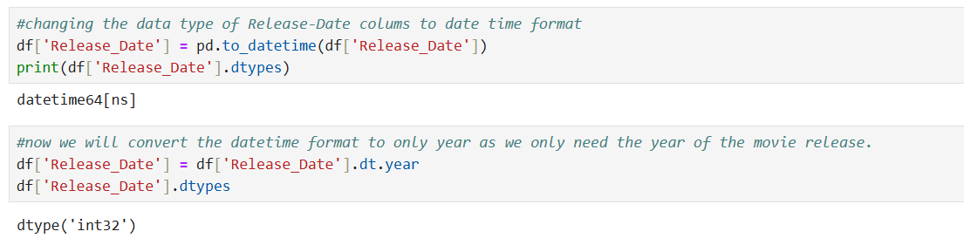
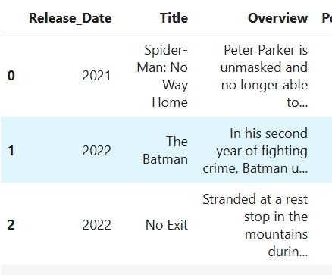
Converting data type of Release date column to Datetime Format
Firstly we converted object data type to date time format.
Then we converted the complete data format in year as we only need the year of release of any movie.
As a result we can see that the release_date column is now showing only the year.

Slide 12
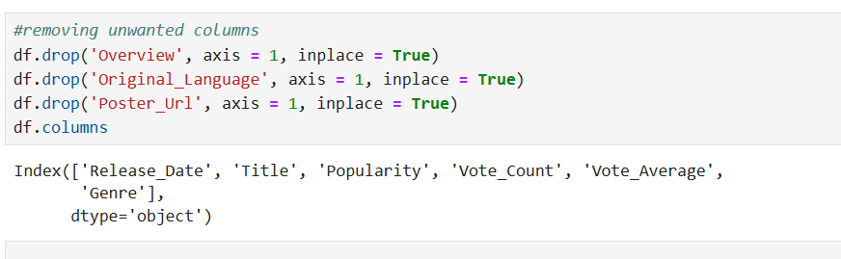
Removal of unnecessary Columns-:

Slide 13
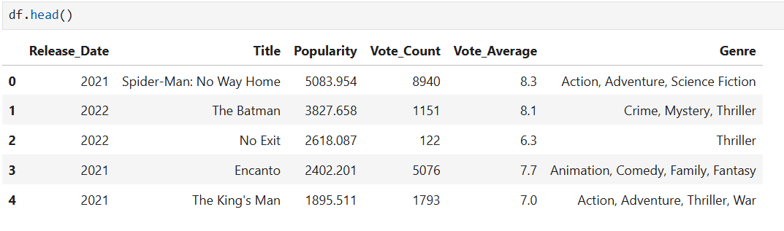
Our New data is like-;
We can see the columns are dropped and the Release column contains only the year.

Slide 14
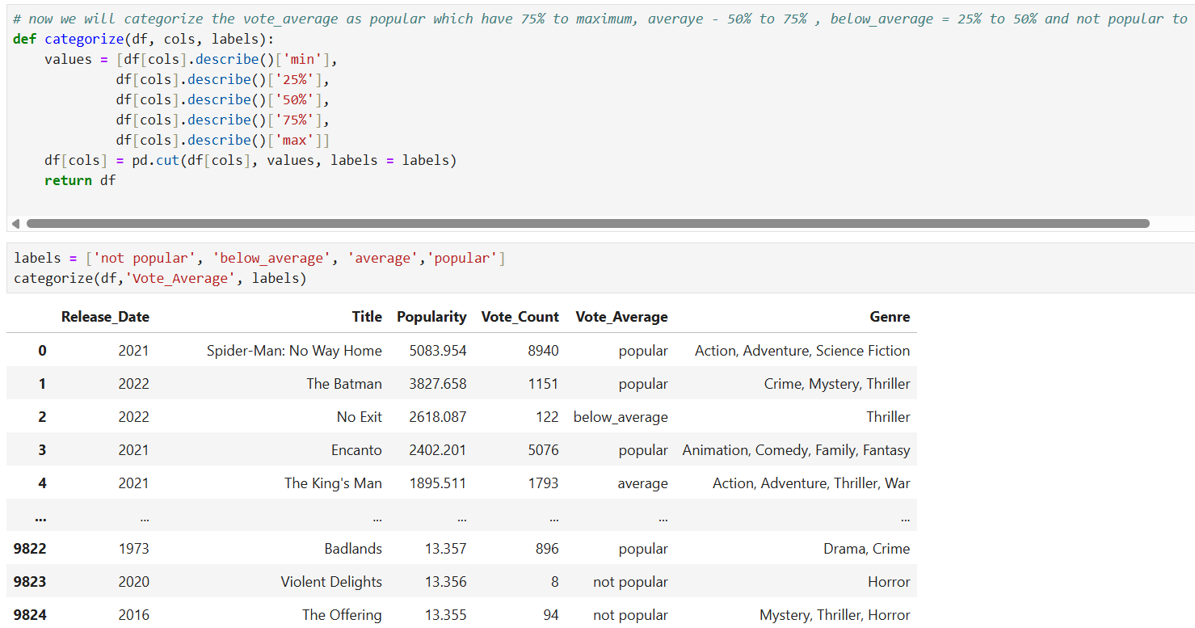
Categorizing the Vote_Average column
Now we are categorizing like -: 0 to 25% = not popular, 25 to 50 – below average, 50 to 75 = average, 75 to maximum = popular

Slide 15
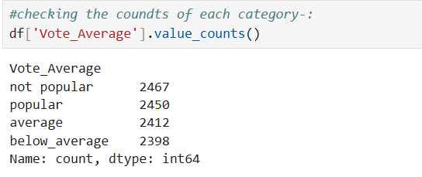
Checking the sum of each categories-:

Slide 16
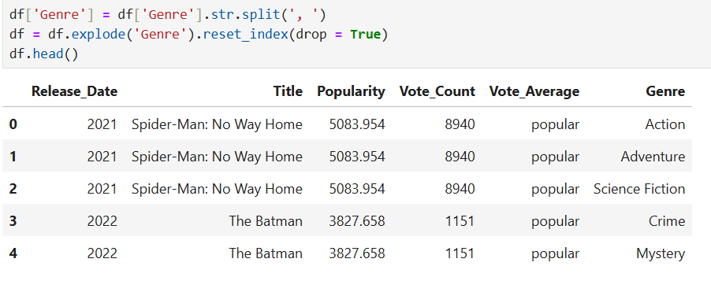
Splitting the Genre Column
This will increase the number of rows.

Slide 17
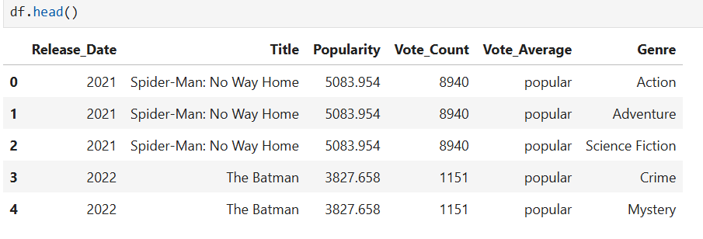
Now our data is completely organized.
Our data is ready to find out the insights and visualizations.

Slide 18
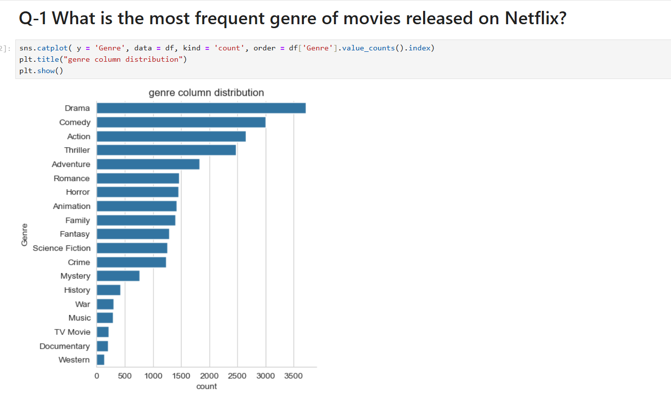
Answers of all Questions-:

Slide 19
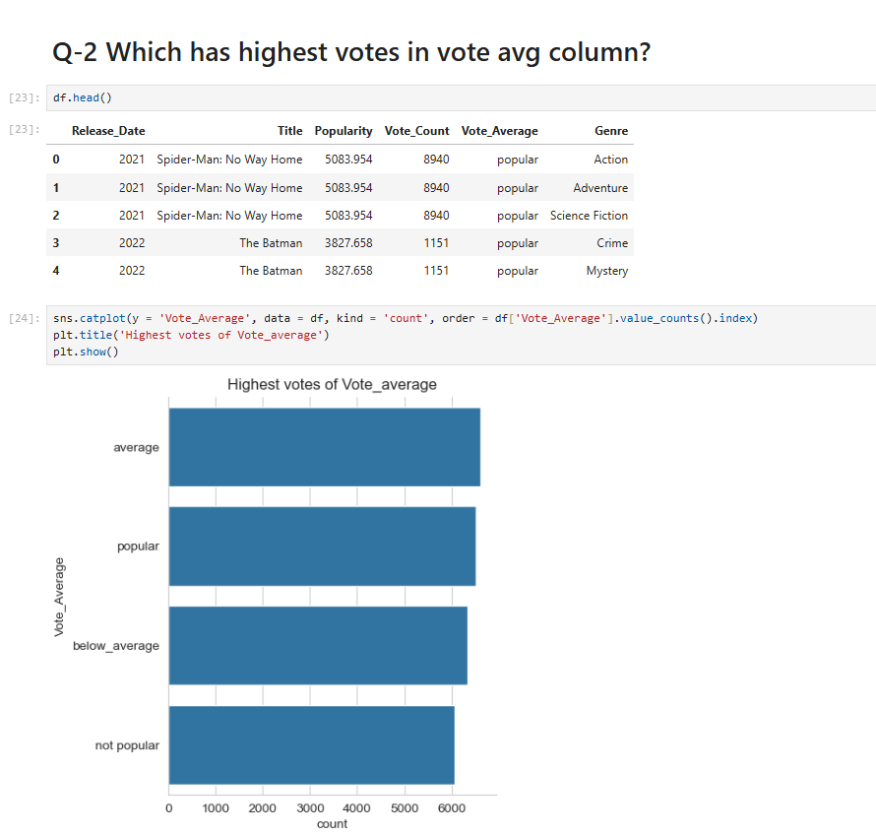

Slide 20
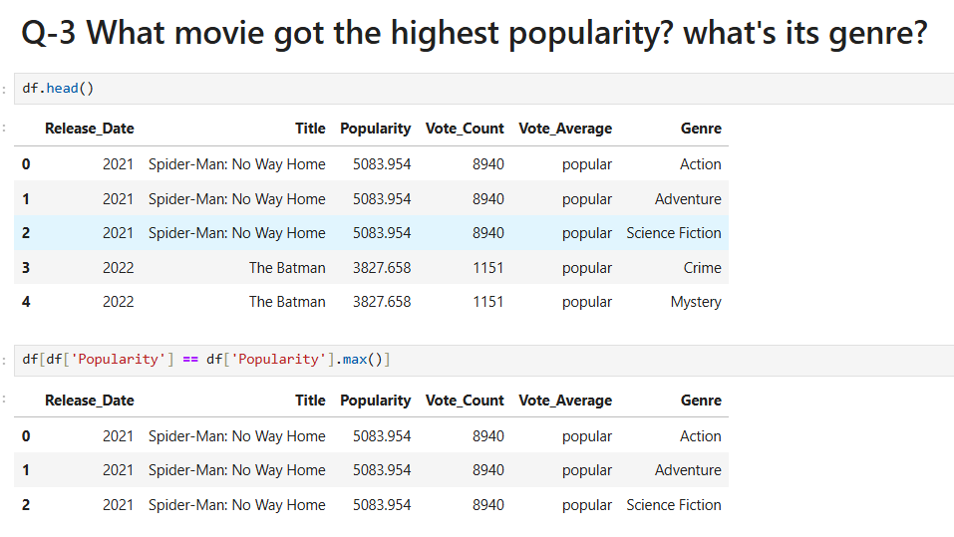

Slide 21
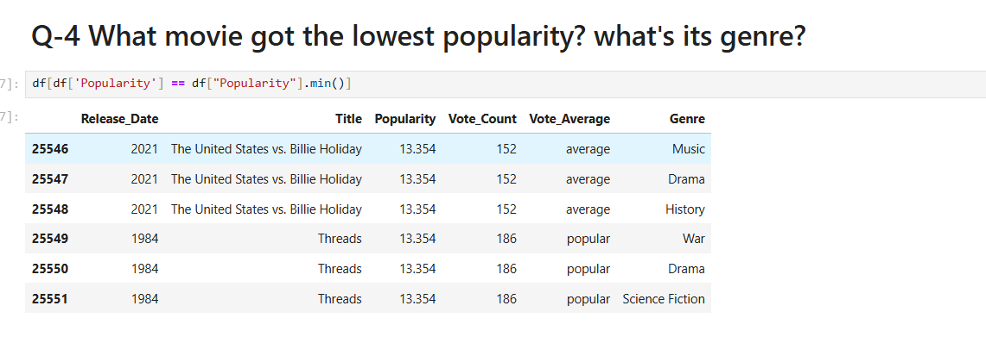

Slide 22
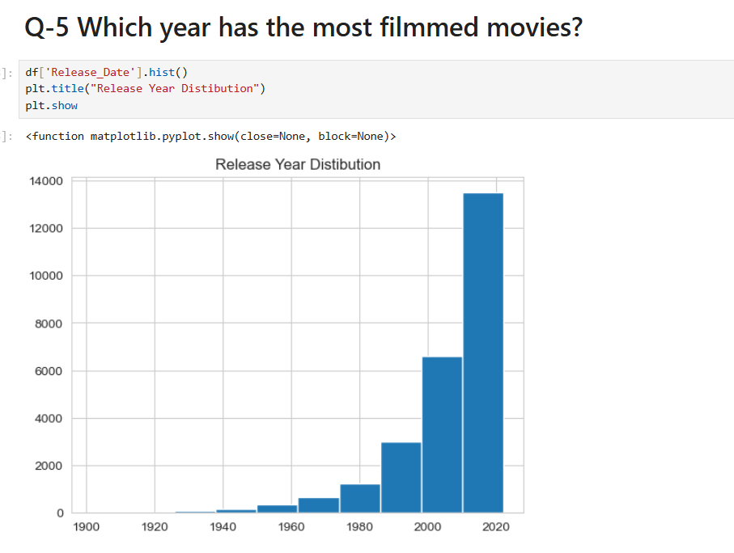

Slide 23
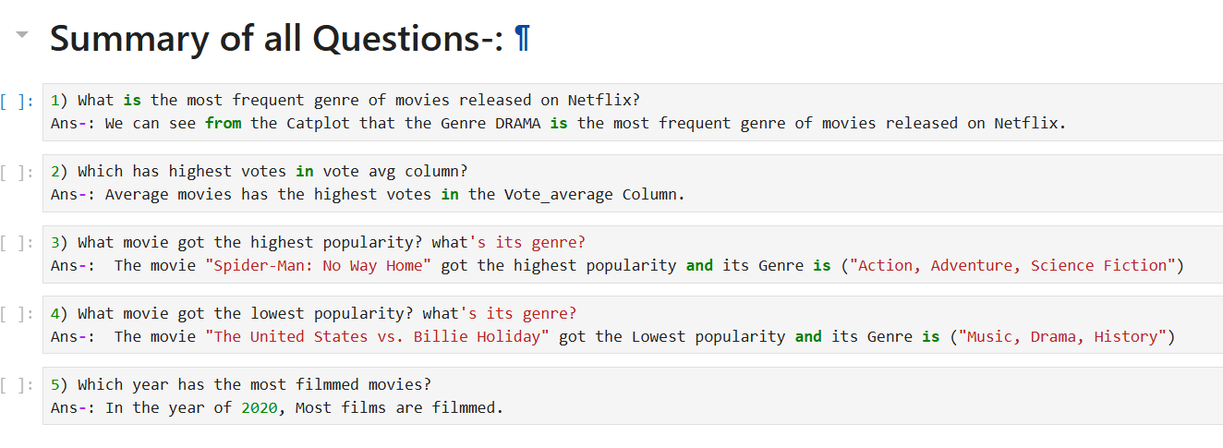

Slide 24
Thankyou
Report by-: Nitin Sharma
Contact -: 9306639136
Date -: 15/May/2025

